Slide 1
Physics 2 – April 12, 2019
P3 Challenge – What is the sign of W, the work done by a gas during a) an expansion, and b) a compression.
Today’s Objective:
Laws of Thermodynamics
Assignment:
B.2 p33#24-31,33
Get out 18-23 for HMK check
Agenda
First Law of Thermodynamics
Sign Conventions
First Law and Processes
Molar Heat Capacity
Second Law
Group summary tables on WB

Slide 2
First Law of Thermodynamics
When heat is added (removed) to a gas, it can be used in two different ways:
The heat may increase (decrease) the temperature of the sample of gas
Or it may cause the gas to expand (compress) doing some positive (negative) PV work,
Or some combination of the two options.
Q = U + W
This is the First Law of Thermodynamics.
=
+
Q | U | W
Positive Heat added | Positive Temp Increase | Positive Expansion
Negative Heat removed | Negative Temp decrease | Negative Compression

Slide 3
Alternate First Law of Thermodynamics
The change in internal energy of a closed system is equal to the amount of heat added to the system less the work done by the system.
U = Q – W
Notice in this form, a state function is dependent on two non-state functions.
First Law of Thermodynamics is also called the Law of Conservation of Energy.
=
–
U | Q | W
Internal E Increase | Heat added to gas | Positive W done by gas
Internal E Decrease | Heat removed from gas | Negative W done by gas

Slide 4
Sign conventions for First Law U = Q – W
W > 0 for expansion (work done by the gas)
W< 0 for compression (work done by the gas) W = PV
Q > 0 for heat added to system (endothermic)
Q < 0 for heat removed (exothermic) Q = U + W
U > 0 if temperature increases.
U < 0 if temperature decreases. U = 3/2 nRT

Slide 5
First Law Problems
Remember to think about the sign conventions. It helps to think about energy like money.
Ex: 5000 J of heat are added to two moles of an ideal monatomic gas, initially at a temperature of 500 K, while the gas performs 7500 J of work. a) What is the change in internal energy of the gas? b)What is the final temperature of the gas?

Slide 6
First Law Consequences for Processes
Given U = Q – W
Isothermal process T = 0 So U=0 0 = Q – W therefore Q = W
Isobaric process W = PV nothing else special
Isovolumetric process W = 0 U = Q
Adiabatic process Q = 0 U = – W

Slide 7
Molar Heat Capacity
Molar Heat Capacity is the amount of energy required to change the temperature of one mole of the gas by 1 K.
It is given the symbol C_{p} if the heat transfer occurs at constant pressure and C_{v} for a constant volume heat transfer. (Problem 33 asks you to relate these two.)
The amount of heat can be calculated from nC_{p}T for isobaric processes, or nC_{v}T for isovolumetric processes, just like we calculated heat from specific heat capacity as mcT

Slide 8
Heat for the other processes
For an isothermal process, the heat transfer can’t be calculated with a mcT style formula because T is zero. Heat must be calculated from an evaluation of work. because Q = W.
For an adiabatic process, Q = 0. By definition.

Slide 9
Calculating internal energy
Consider an isovolumetric process. V = 0, so W = 0.
From the first law, U = Q = nC_{v}T
Now recall that internal energy ONLY DEPENDS ON TEMPERATURE. U = 3/2 nRT Compare to see that C_{v}=3/2 R
If you have a temperature change for any process, you can calculate the change in internal energy using U = nC_{v}T.
U = nC_{v}T holds even when T = 0, but reduces to U = 0.
https://www.youtube.com/watch?v=AsjLI3g9feU&list=PLX2gX-ftPVXVfoaIeiZcVZcHyeSpdkHKo Thermo Review videos by a great guy. He’s very clear and correct.

Slide 10
Second Law of Thermodynamics
The total entropy of an isolated system can only increase over time or remain constant.
In ideal cases where the system is in a steady state (equilibrium) or undergoing a reversible process, there is no change in entropy.
The increase in entropy accounts for the irreversibility of natural processes, and the asymmetry between future and past. The arrow of time only goes one way.

Slide 11
Factors affecting Entropy
Entropy is a measure of the amount of disorder in a system or a counting of the number of possible arrangements of items.
State of sample: Gases have more entropy by far than liquids, which have more entropy than solids.
Size of sample: a larger number of particles will have a larger entropy
Temperature of sample: a higher temperature will have more entropy

Slide 12
Calculating Entropy Change
Significant entropy change happens during phase changes.
When heat is added or removed from a system at a constant temperature (so for a phase change) the change in entropy is given by an equation. This is the only time you’ll calculate S.
$∆S=\frac{Q}{T}$
Symbol for entropy: S
Unit for S is J/K
Entropy is a state function – it has a value that is path independent

Slide 13
Qualitative Change in entropy , signs
If heat is added, Q > 0 and S is positive.
If heat is removed, Q < 0 and S is negative.
For the special cases where a process is reversible, S = 0
Consider state changes, comparison of size of sample items, and possible temperature differences.
IB will expect you to be able to state the sign of S for any process and be able to justify your answer with an argument.

Slide 14
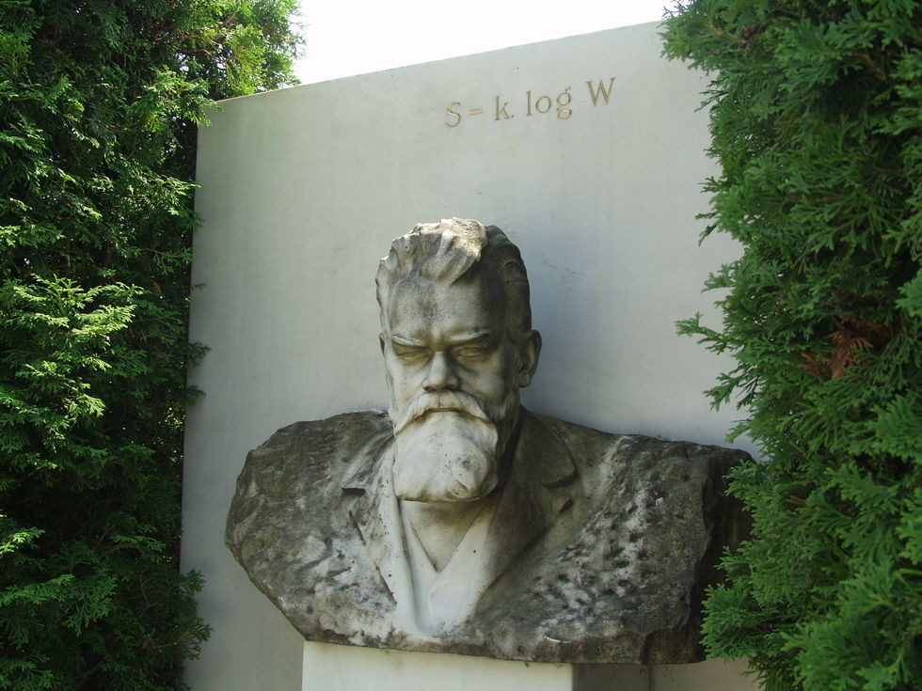
Father of entropy, Boltzmann
It is possible to calculate a value for entropy using statistical mechanics with a zero entropy being a single particle at absolute zero as a reference. S= k_{B} log W, where W is the number of possible unique particle states.
I think it’s appropriate for a grave marker because the body decomposes and becomes more entropic after death.
Boltzmann’s Grave in Vienna

Slide 15
Summary table for formulas
Work together on white boards to complete the summary table. Work for isothermal is given because it requires calculus to evaluate.
Process U = Q - W | Internal Energy Change, U | Heat transfer to gas, Q | Work done by gas, W
Isobaric
Isovolumetric
Isothermal |  |  | nRT ln(V₂/V₁)
Adiabatic

Slide 16
Summary table, Answers
Process Zero value U = Q – W | Internal Energy Change, U | Heat transfer to gas, Q | Work done by gas, W
Isobaric P = 0 | nC_{v}T | nC_{p}T | PV
Isovolumetric V = 0 | nC_{v}T | nC_{v}T | 0
Isothermal T = 0 | 0 | nRT ln(V₂/V₁) | nRT ln(V₂/V₁)
Adiabatic Q = 0 | nC_{v}T | 0 | – nC_{v}T

Slide 17
Exit Slip - Assignment
Exit Slip- 900 joules of heat are added to a system and 200 joules of work are done on the system. What is U?
What’s Due? (Pending assignments to complete.)
B.2 p33#24-31,33
What’s Next? (How to prepare for the next day)
Read B p23-32 about Thermodynamics

